Slide 1
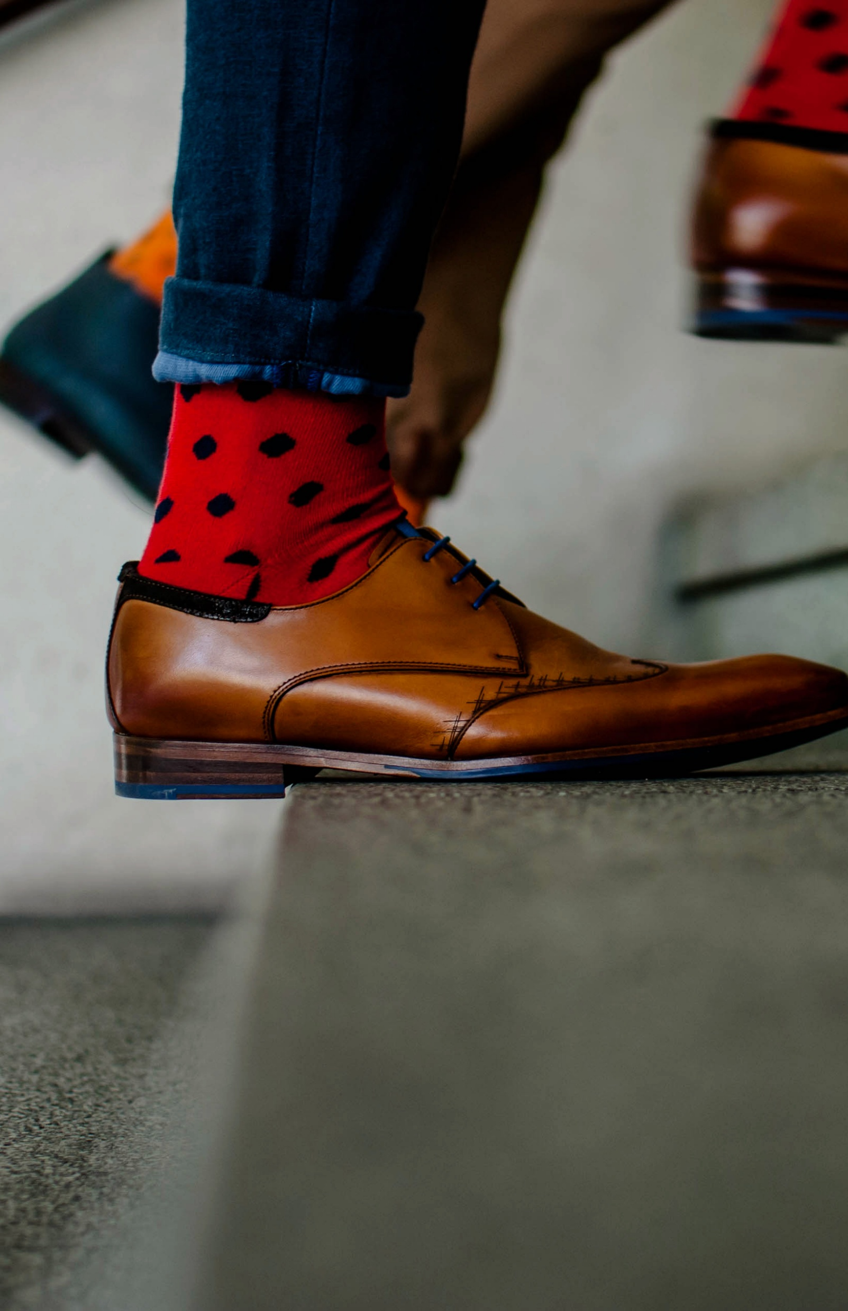
Do you take the stairs instead of the elevator?
Well done!
Move more and sit less at work
Taking the stairs saves electricity because you burn calories
You can also take the stairs for only part of the way up
Ask a colleague to join you. Taking the stairs together is more fun
Out of breath? Well done: it means your blood is flowing
Add your own logo here

Slide 2
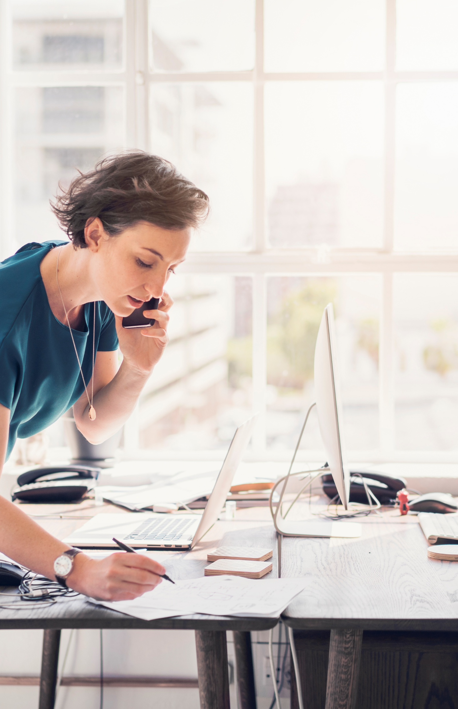
Do you change working postures?
Well done!
Move more and sit less at work
Get moving by varying your work activities:
  Alternate between sitting and standing by using a sit–stand desk (please note: limit standing to no more than 1 hour at a time and no more than 4 hours per day).
  Alternate computer work with phone calls, and move around while you are on the phone
  Alternate writing tasks with meetings, and move during meetings or in between activities
Add your own logo here

Slide 3
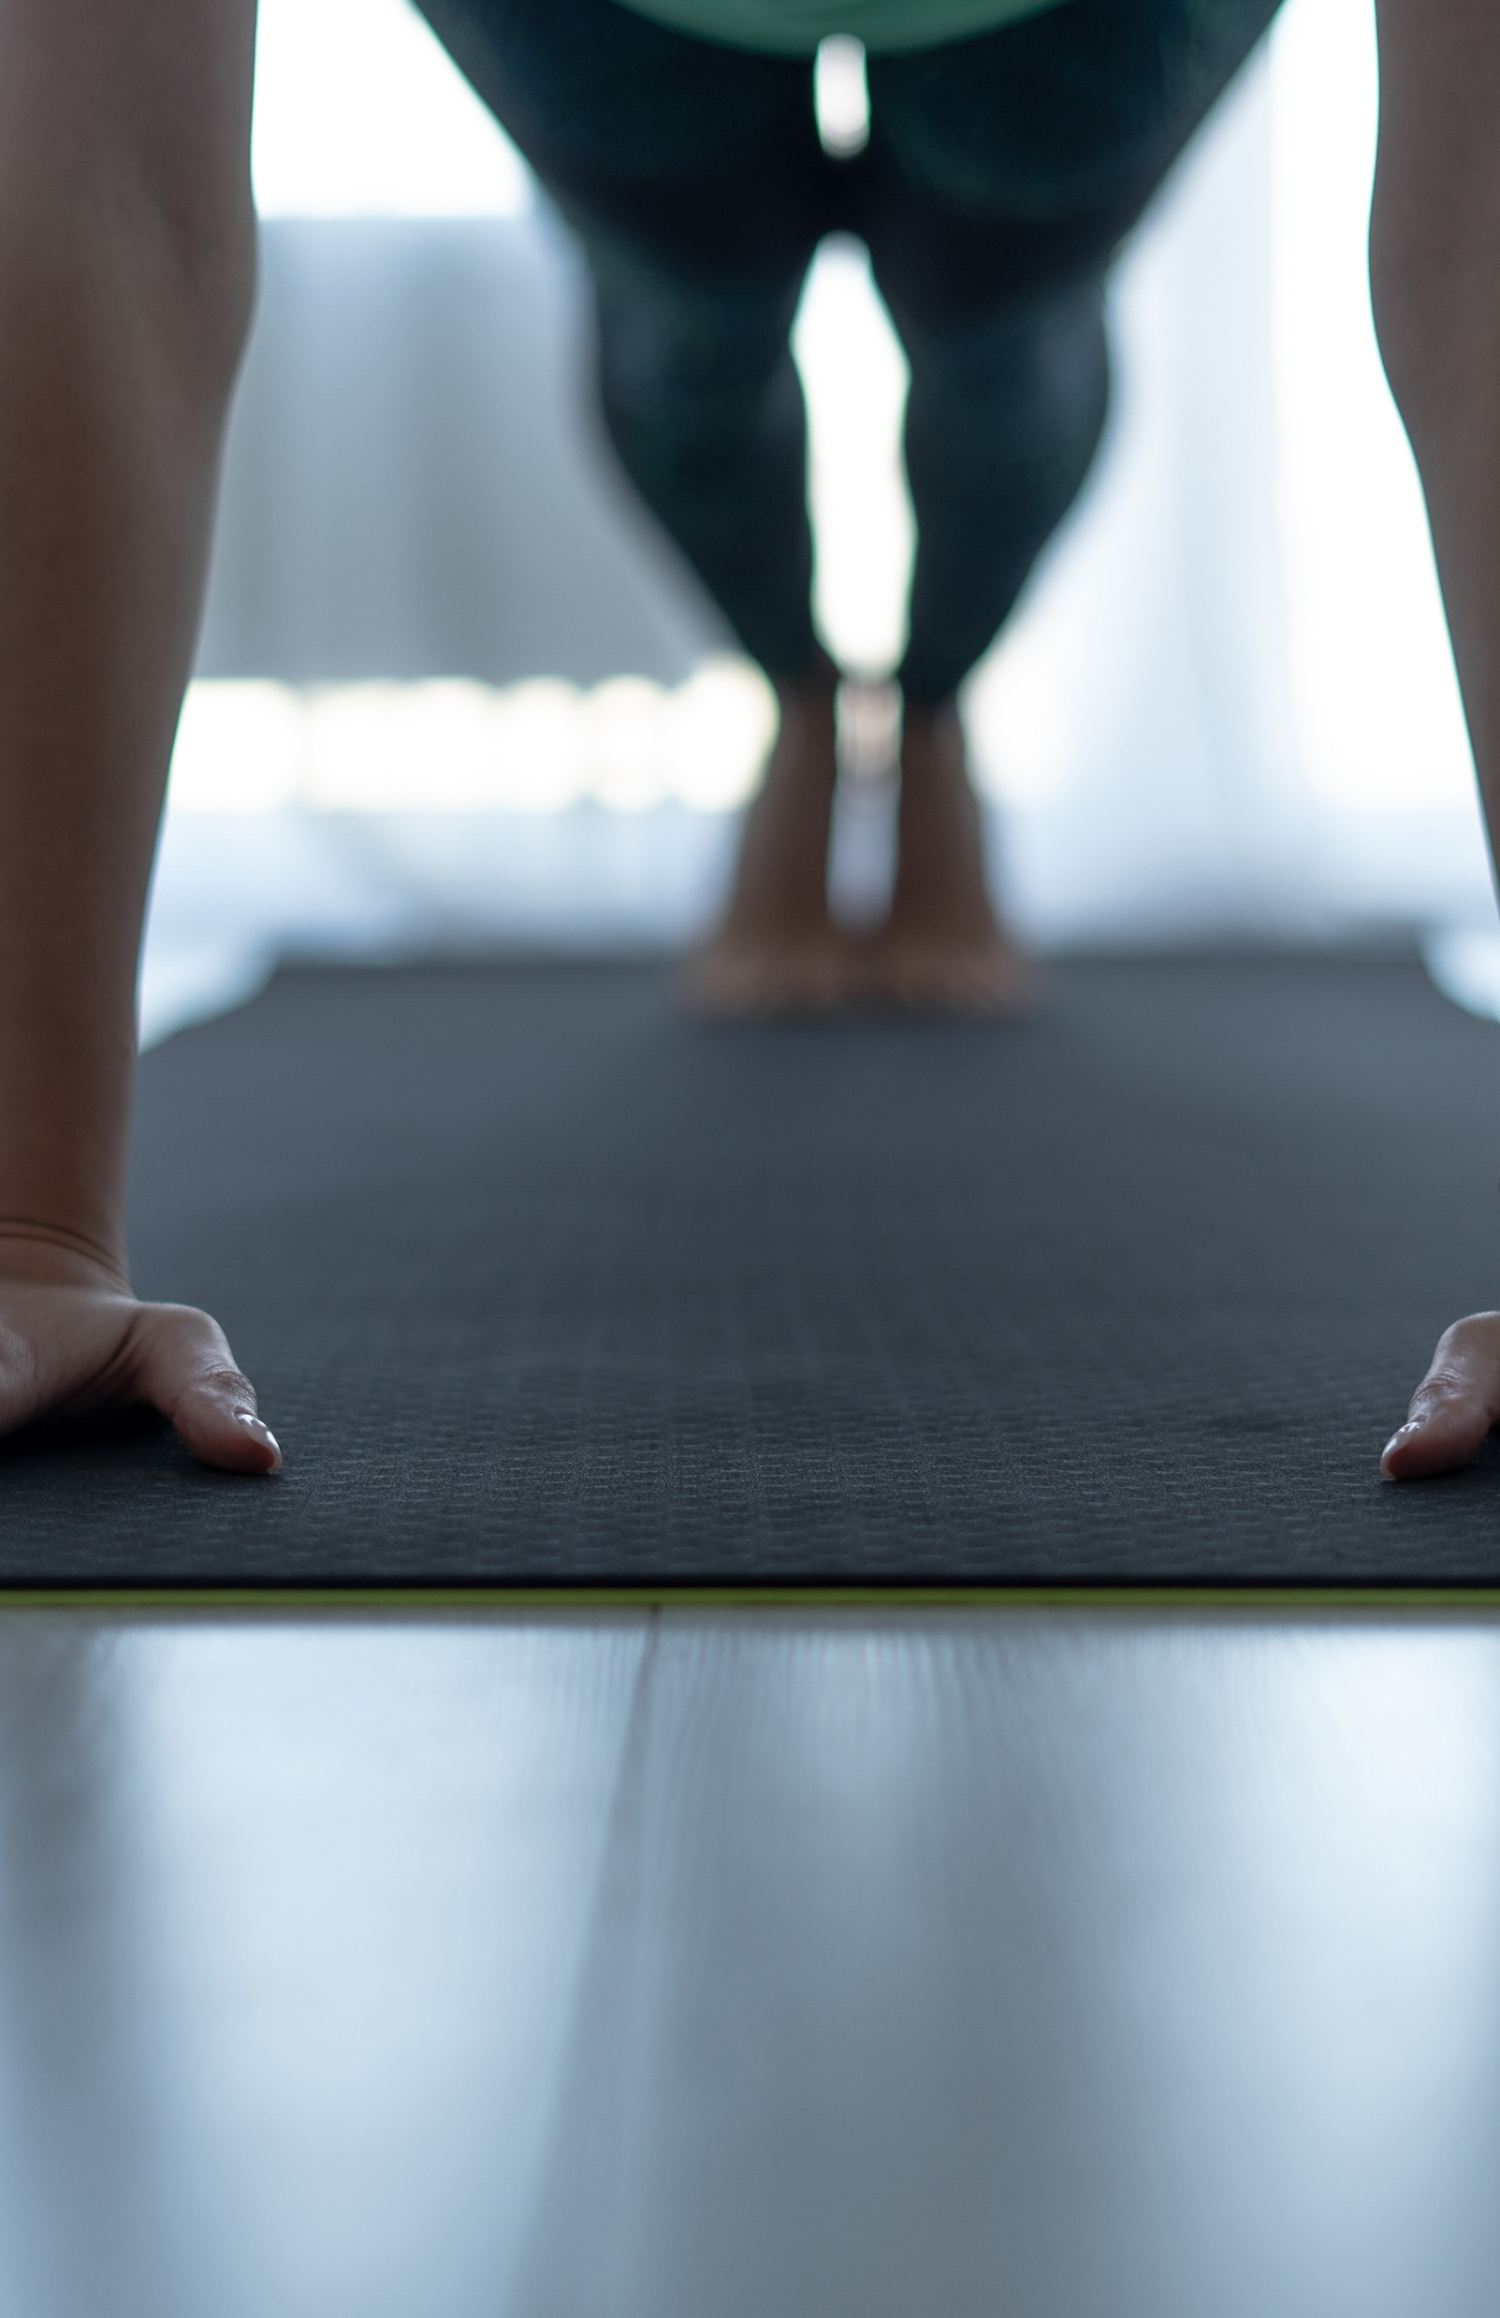
Add your own message here
Well done!
Move more and sit less at work
…
Add your own logo here

